Slide 1
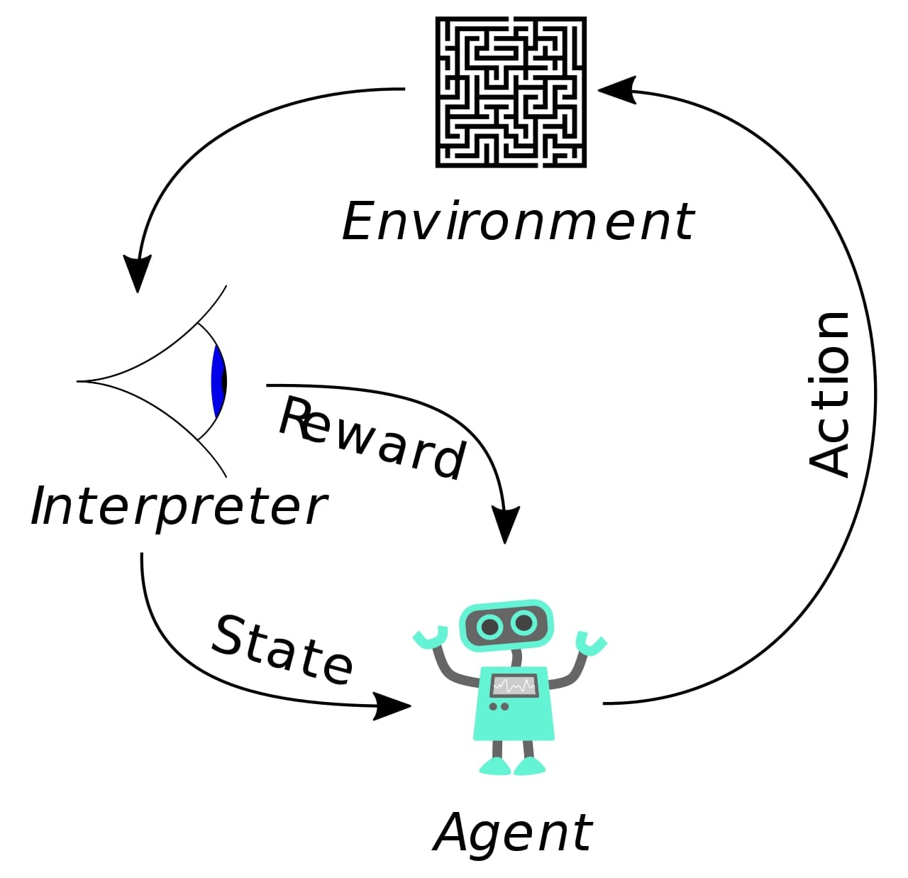
The Adventure of an RL Agent

Slide 2

Introduction to Reinforcement Learning
Reinforcement Learning (RL) is a type of machine learning where an agent learns by interacting with an environment to maximize cumulative reward. The goal of my learning was to understand the foundations of RL and apply it practically to different problems.

Slide 3
Key Foundations of RL
Agent: The learner or decision maker
Environment: The world the agent interacts with
State: Current situation of the agent
Action: What the agent can do
Reward: Feedback from the environment to guide learning
Policy: A strategy that maps states to actions
Value Functions & Q-Learning: Methods to estimate expected rewards
Deep Q Networks (DQN): Use of neural networks to approximate Q-values for large state spaces

Slide 4
The Q-learning algorithm works as follows:
Initialize all Q-values (action-value function).
For each episode, start from the initial state.
At each step, select an action using the epsilon-greedy strategy (explore or exploit).
Perform the action, observe the reward and the next state.
Update the Q-value using:
Q(s, a) = Q(s, a) + α * [r + γ * max(Q(s’, a’)) — Q(s, a)]
where α is the learning rate and γ is the discount factor.
If the next state is terminal, update Q using the reward only.
Set the current state to the next state and repeat until the episode ends.
After training, the best action for any state is the one with the highest Q-value in that state.

Slide 5
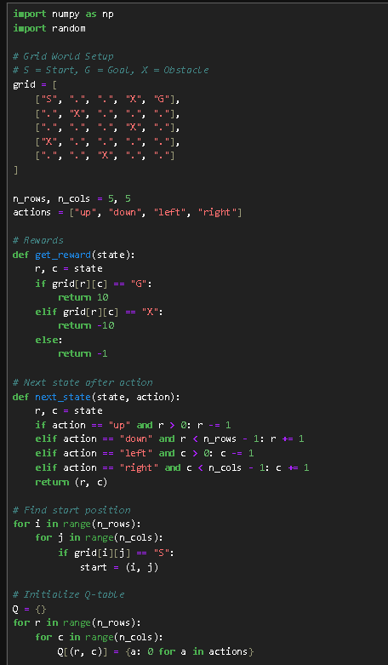
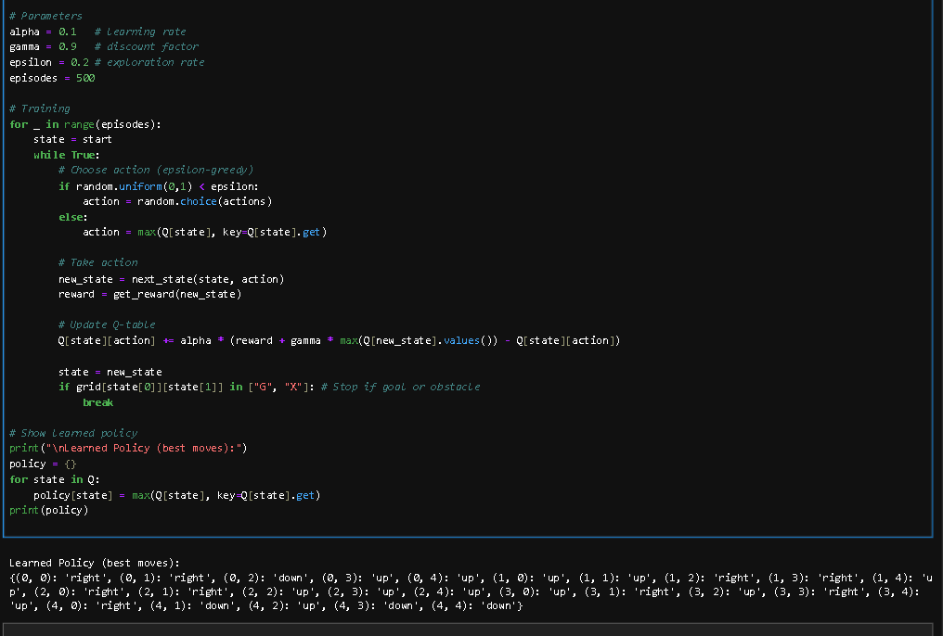

Slide 6
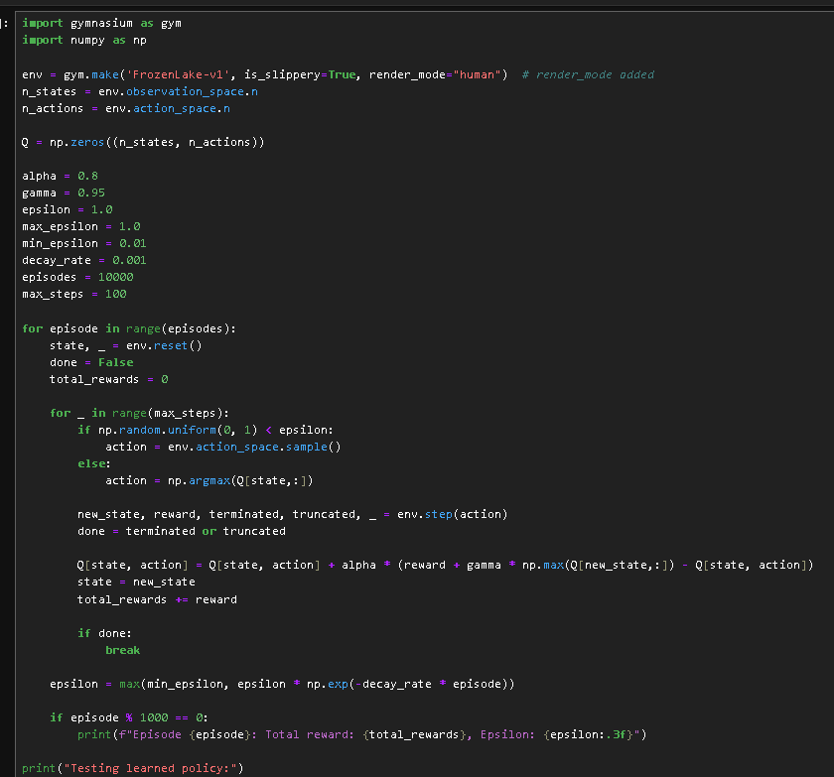
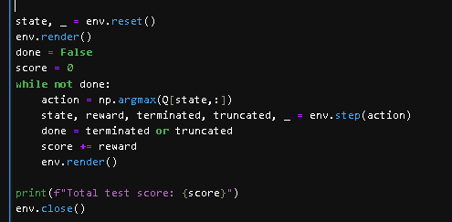
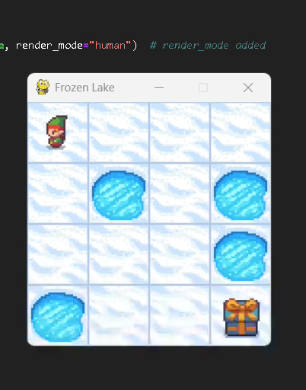

Slide 7
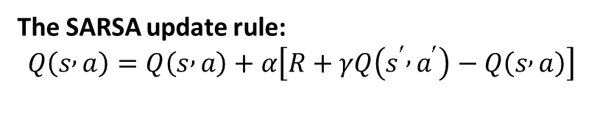
What is SARSA in Reinforcement Learning?
State – Action – Reward – State – Action
SARSA learns by updating the Q-value of the current state–action pair using the reward it got and the Q-value of the next state–action pair that the agent actually chose.
The SARSA update rule:
$$Q\left(s , a\right)=Q\left(s , a\right)+α\left[R+γQ\left(s^{′} , a^{′}\right)−Q\left(s , a\right)\right]$$
SARSA vs Q-learning :
Concept | SARSA | Q-learning
Type | On-policy | Off-policy
Next Action | Uses the actual action taken | Uses the best possible action (max Q)
Update Target | R+γ Q(s′,a′) | R + γmax a′​Q(s′,a′)
Behavior | Learns what it does | Learns what it should do ideally
Result | Safer, more conservative | Often more optimal but riskier

Slide 8
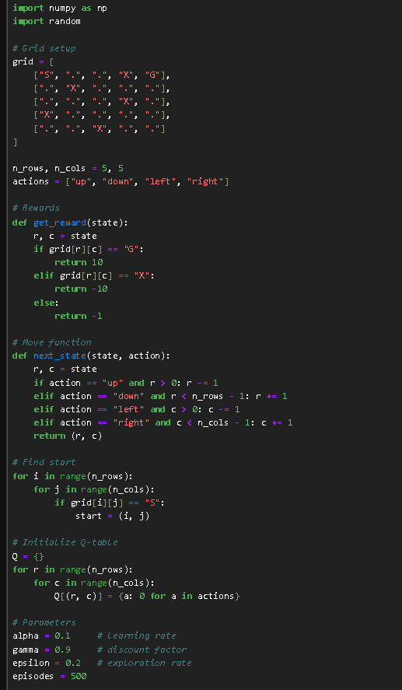
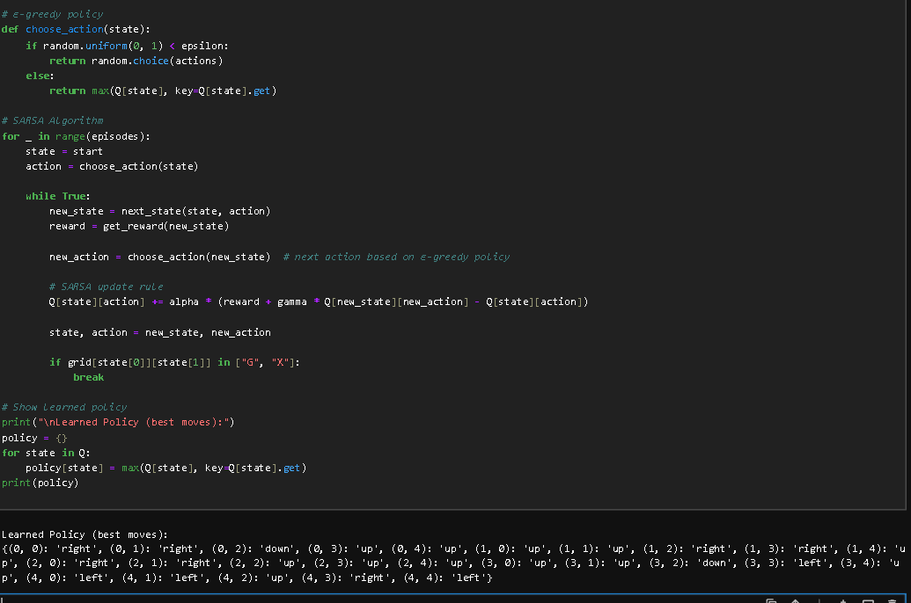

Slide 9
Practical Project – CartPole
The CartPole task involves balancing a pole on a moving cart by applying forces left or right. I implemented Q-learning / Deep Q Network to solve this problem. The model was able to successfully balance the pole for a significant duration (X steps). This project taught me the importance of balancing exploration and exploitation in RL.

Slide 10
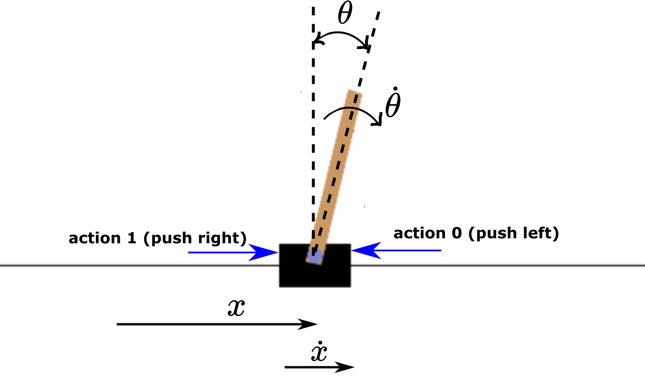
The control goal is to keep the pole upright by applying forces to the cart.
The observation space includes:
- Cart position: range [-4.8, 4.8]
- Cart velocity: range [-infinity, infinity]
- Pole angle (radians): range [-0.418, 0.418]
- Pole angular velocity: range [-infinity, infinity]
Action space: 0 = push left 1 = push right

Slide 11
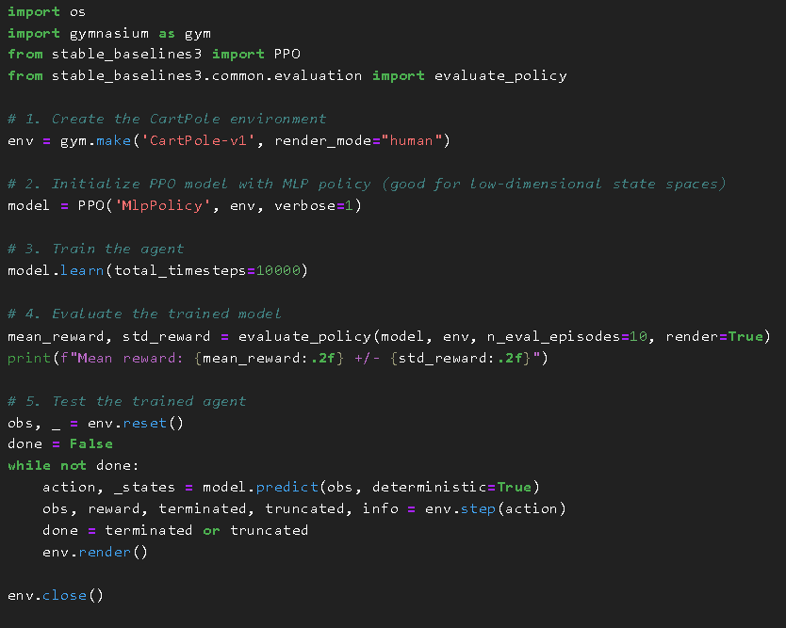
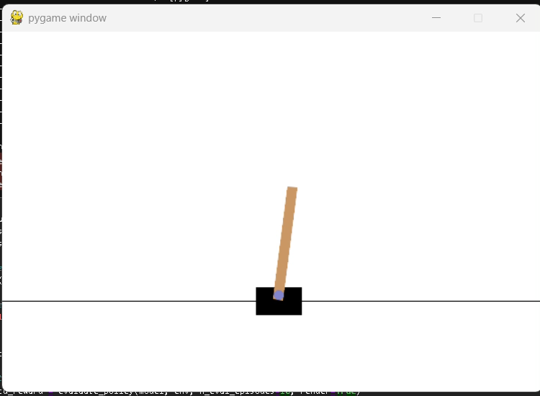
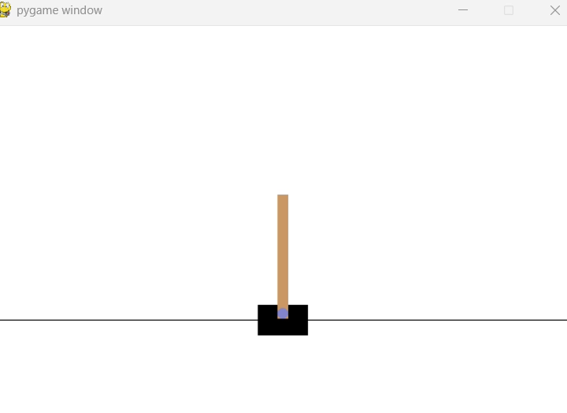
Before training
After training

Slide 12
Practical Project – Breakout Game (Atari)
Deep Q Networks were used to train an agent for Breakout. The challenges included high-dimensional visuals and sparse rewards. Despite these, the agent learned to play better and improve its score over time.
Practical Project – Self-Driving Car Simulation
Deep Q Networks use experience replay and neural nets to train agents on Breakout. The method handles complex visuals and sparse rewards, enabling the agent to improve and score higher over time.

Slide 13
Challenges Encountered
Understanding complex RL algorithms and their mathematical foundations
Ensuring training stability and managing long training times
Tuning hyperparameters to improve performance and convergence
Overcame these by experimenting with parameters, consulting online resources, and iterative testing

Slide 14
Key Learnings and Insights
RL requires a good balance between exploring new actions and exploiting known good actions.
Combining deep learning with RL (e.g., DQN) can handle more complex problems with large state spaces.
Practical projects helped reinforce theoretical knowledge and gave hands-on experience.
Patience and iterative improvement are essential due to the trial-and-error nature of RL training.

Slide 15
Next Steps and Future Goals
Learn and implement advanced RL algorithms like Proximal Policy Optimization (PPO), Advantage Actor-Critic (A3C), and Soft Actor-Critic (SAC).
Apply RL methods to robotics and more complex simulation environments.
Explore multi-agent reinforcement learning scenarios.
Continue to improve my existing projects and experiment with real-world applications.

Slide 16
Thank You

